Slide 1
How big is the ARC?
George Wilson
Delphix

Slide 2

Problem: Reduced caching since switching to linux

Slide 3
ARC Memory Configuration
max (½ of memory)
min
Linux
max (memory - 1GB)
min (⅛)
Illumos

Slide 4

Simple fix, increase the ARC size!

Slide 5
ARC Memory Future
max (memory - 1GB)
min
Delphix
max (memory - 1GB)
min
FreeBSD
max (memory - 1GB)
min (⅛)
Illumos

Slide 6



Slide 7
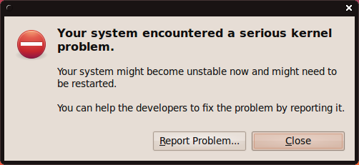
Problem: iscsi LUN resets

Slide 8
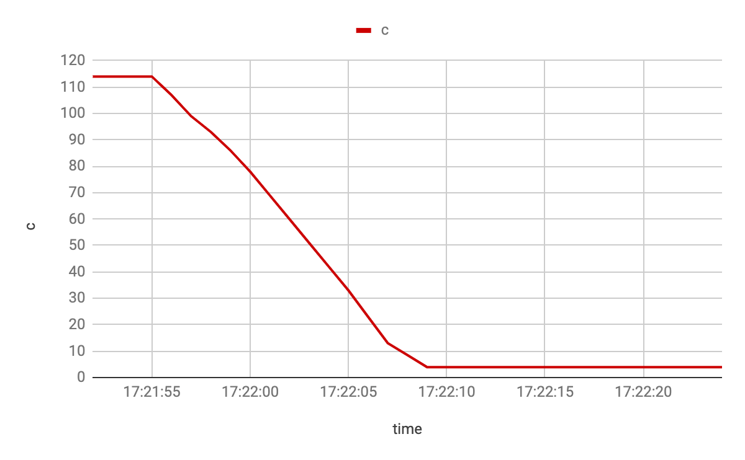
ARC Collapse

Slide 9
Memory Pressure Affects
Expected Workflow
Actual Workflow
Kernel Memory Pressure
Kernel Memory Pressure
arc_reap thread
arc_evict thread
arc_reap thread
arc_evict thread
shrinker
detects memory shortfall
evicts from arc
detects memory shortfall
evicts from arc
get freeable objects
shrinks arc
wakes up any blocked threads
shrinks arc
wakes up any blocked threads
shrinks arc

Slide 10
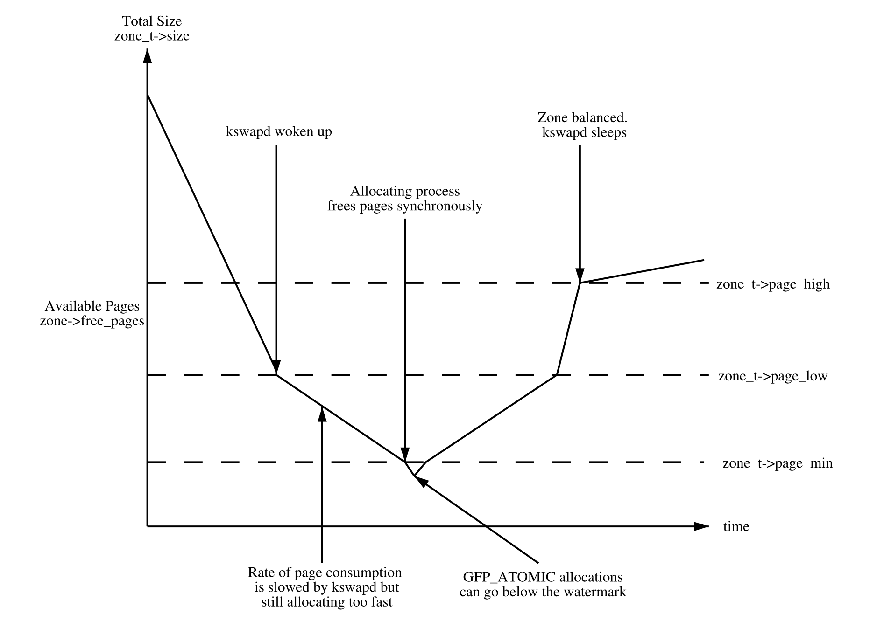
Two types of memory pressure
Direct
Synchronous memory reclaim
Invoked in the context of the running thread
Indirect
Performed by kswapd
Wakes up when memory zone’s watermark crosses the WMARK_LOW threshold

Slide 11
ARC shrinker
arc_shrinker_func_count_objects()
Returns amount of evictable memory in pages to the kernel
arc_shrinker_func_scan_objects()
Shrinks the ARC target size by requested amount

Slide 12
Actual Memory Pressure
====== 20s Sample =====
@[
arc_reduce_target_size+1
arc_shrinker_func_scan_objects+17
do_shrink_slab+297
shrink_slab+214
shrink_node+229
balance_pgdat+628
kswapd+369
kthread+289
ret_from_fork+31
]: 198874
All memory pressure coming from kswapd
arc_reap thread never detects memory pressure
Over 9000+ calls per second
Kernel never seems satisfied by any progress made by the ARC

Slide 13
How does this relate to our problem?

Slide 14
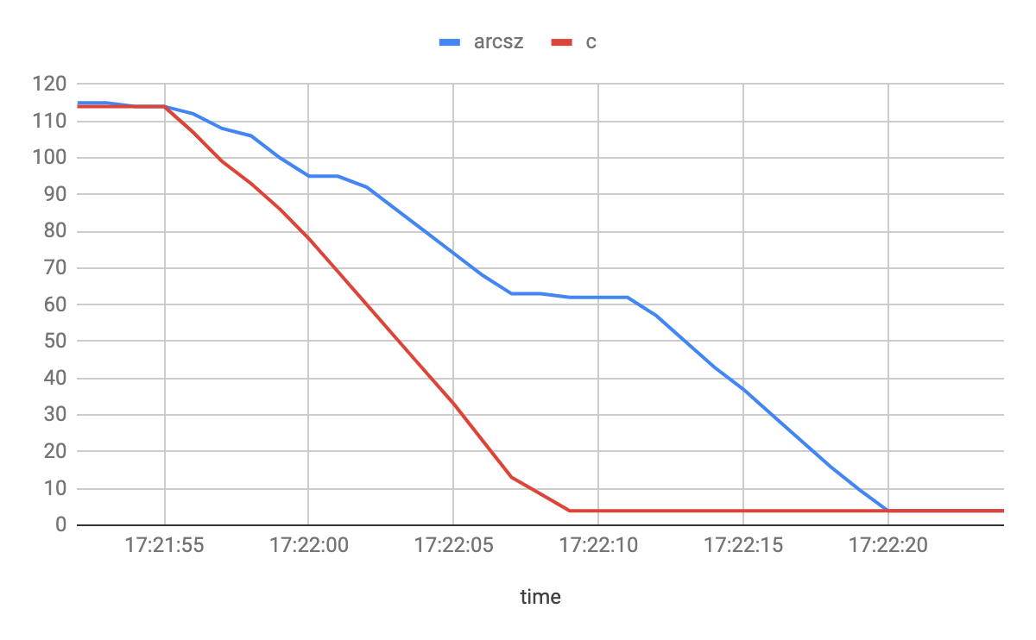
Looking at ARC size
arc_evict
kswapd

Slide 15
What is really happening?
Adding to the ARC:
Is ARC overflowing?
Allocate a block from the ARC
Yes
Block until arc_size less than arc_c
No
Continue

Slide 16
Read Delay
25s Delay
arc_read

Slide 17
Issues with arc shrinker
Repeated calls for direct and indirect page reclaims
Calls into arc_shrinker_[count|scan]
ARC may collapse to arc_c_min
Introduces I/O stalls
Kernel has no idea how much memory has been evicted
Cumbersome interaction with arc_reap thread

Slide 18
Improving memory pressure detection

Slide 19
Improved ARC shrinker
arc_shrinker_count()
Limit the number of pages the ARC shrinker will make available for eviction
Defaults to 10,000
arc_shrinker_scan()
Shrinks the ARC target size by the requested amount
Waits for requested amount to be evicted
Notify kernel of evicted pages

Slide 20
arc_wait_for_eviction()
arc_evict_waiters
arc_wait_for_eviction(128)
10284 (+128)
10540 (+256)
11564 (+1024)
11692 (+128)
kswapd
arc_read
arc_read
kswapd
wakeup
384 bytes
arc_evict
arc_evict_count = 10156
evict

Slide 21
I/O under memory pressure
Adding to the ARC:
Is ARC overflowing?
Allocate a block from the ARC
Yes
Block until zfs_arc_eviction_pct amount of data has been evicted
No
Continue

Slide 22
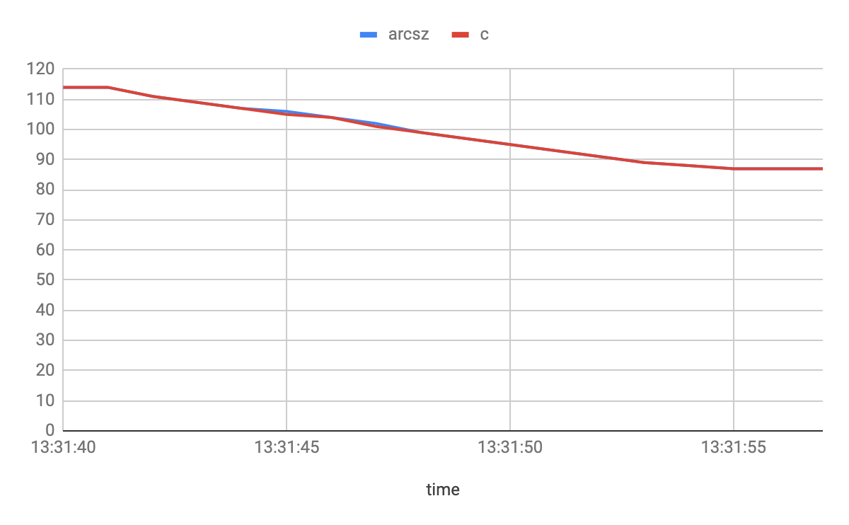
ARC shrinking in lockstep

Slide 23
Questions?

